Slide 1

CS898CA Project 2

Slide 2
Goal of the project
SLAM is considered a fundamental problem for robots to become truly autonomous. It estimates the pose of a robot and the map of the environment at the same time. In this project, students will design different environments (maps) using pybullet, and observe and analyze the provided SLAM algorithm.
The goals are:
Understanding robotics concepts: SLAM
Analyze SLAM algorithm
Robotic programming in Python
Scientific writing

Slide 3
Task List
Understand Slam algorithm
Design 2 different maps, and
Robot navigation from point A (0, 0, 0) to B (20, 12, 0), and record the results
Final report

Slide 4
Task 1: Understand Slam Algorithm
Read the codes in project2.py and answer the following questions
Briefly explain how the algorithm works.
How does the program calculate the velocity of wheels of the robot?
Under what conditions, variable flag_col is True?
How does the algorithm decide the robot reach the target?
The provided algorithm is not very effective, any ideal to improve it?

Slide 5
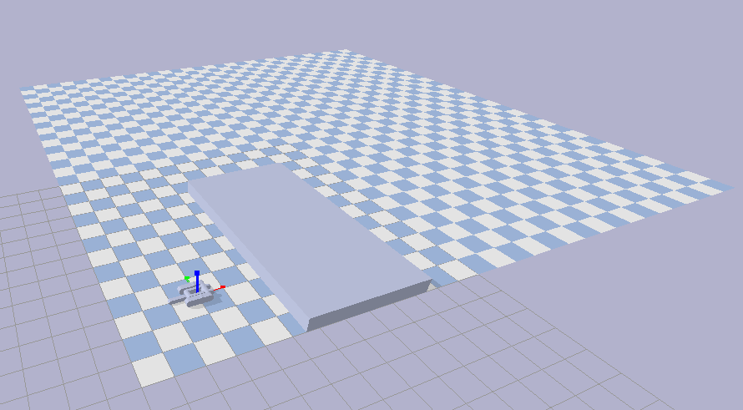
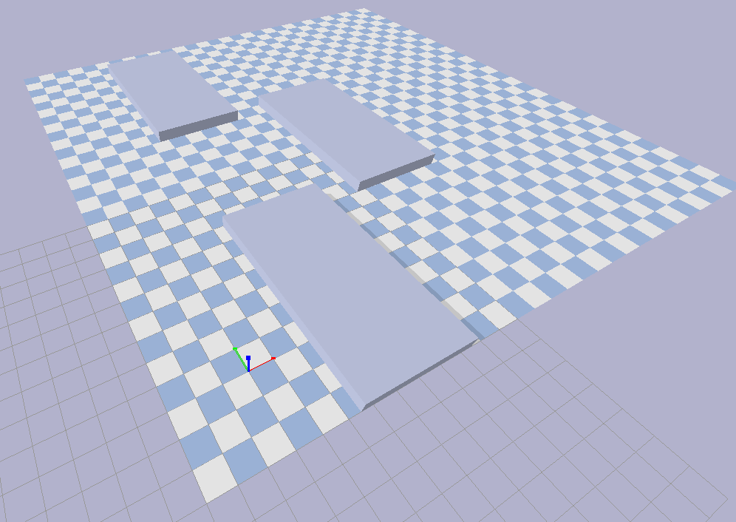
Task 2: Design Maps
The environment initially includes 1 obstacle (map 1), your task is to modify the importObs function in project2.py to generate a new map (map 2) with 3 obstacles
Add 2 more obstacles to the map
You can decide the position and orientation of the obstacles
The new obstacles are the same as the initial obstacle (box.urdf)

Slide 6
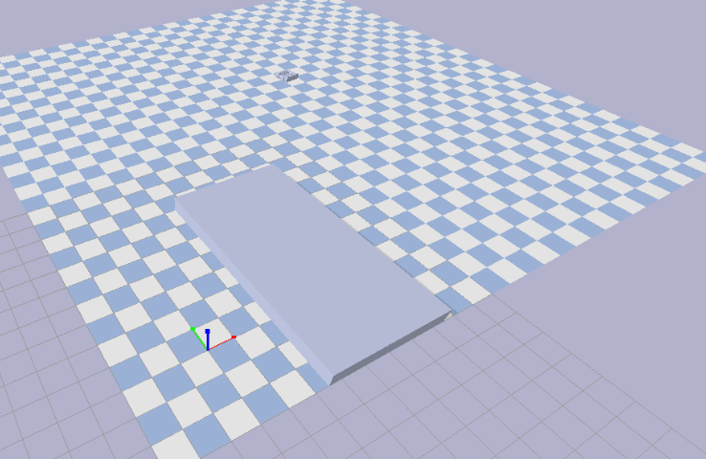
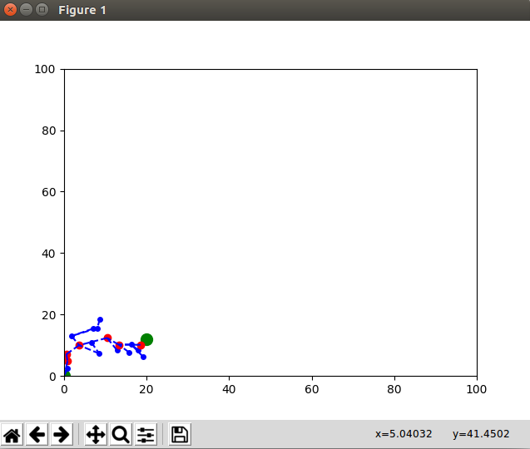
Task 3: Robot Navigation
Run project2.py using the 2 maps and take screen shot of the results of each map navigation
Screen shots of the robot at target location in each of the 2 maps
Screen shots of the trajectory map

Slide 7
Task 4: Final Report
A final report should be submitted, the report includes:
Introduction (5%)
Background
Understanding of Slam and possible application
Brief summary of the project and environment setup
Related Work (20%)
Each student will be assigned a paper (roster2.png)
Summary the motivation, major methods and contributions, and limitations of the selected papers in one paragraph (3-5 sentences)
Project results (55%)
Discuss of the five questions in task 1 (40%)
Results for robot navigation in task 3 (4 figures) (15%)
Conclusion (5%)
Conclude the report, mention the what you have done, and what results you have got.
Appendix (15%)
Paste your source code here

Slide 8
Project Details
Details of project will be explained in the group meeting on Monday 11/16/2020
Due date midnight 12/09/2020

Slide 9
Development Environment & References
OS: Linux, OS, and Windows
Development tool(may need): Python, pybullet
References
Roll, yaw and pinch
https://en.wikipedia.org/wiki/Aircraft_principal_axes
Pybullet start guide https://docs.google.com/document/d/10sXEhzFRSnvFcl3XxNGhnD4N2SedqwdAvK3dsihxVUA/edit#heading=h.2ye70wns7io3

Slide 10


Thank you & Questions?
<number>

